Slide 1
AI BOT FOR IMAGE-BASED PRODUCT RECOMMENDATION SHASHANK PRASAD Student id- 1030468 MS. Artificial Intelligence and Machine Learning DECEMBER 2022

Slide 2
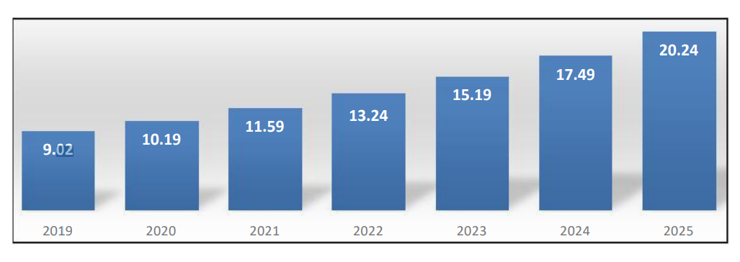
Introduction | Background
We have seen how ecommerce market is growing.
Trends suggests that ecommerce industry will surpass $20 trillion dollars by 2025.
Resulting in increase of E-Commerce application.
Making inconvenient for user to download multiple application and apply filters to find right product.
Filtering in these application is limited to content based and very difficult to for user to find product what they is looking for.

Slide 3
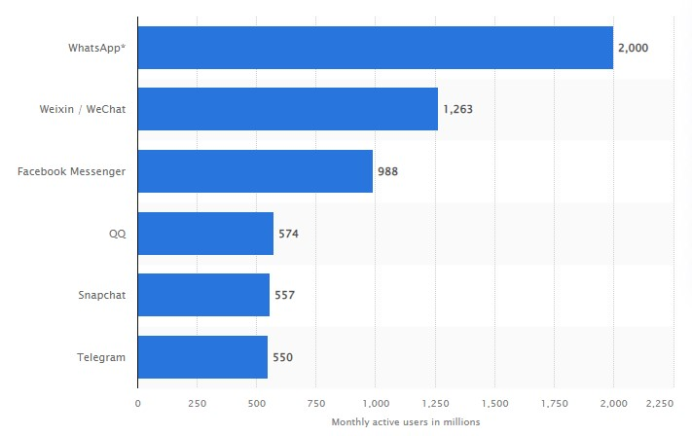
Introduction | Aim and Objective
Other application apart from ecommerce app have shown growth is of instant messaging app.
Trend suggests there are more 3 billion monthly active user across different instant messaging app.
Aim and Objective
Build recommendation system which recommend product based on visual/ features and similarity.
Identify best model to achieve high accuracy with less loss.
Integrate image based recommendation system with instant messaging application via bot to recommend product based on user interest.

Slide 4
Literature Review
2012
Modeling the Visual Evolution of Fashion Trends with One-Class Collaborative Filtering
(Stewart, 2012)
2015
Image-based Product Recommendation System with Convolutional Neural Networks
(Chen et al., 2015)
2020
Image-Based Service Recommendation System: A JPEG-Coefficient RFs Approach
(Ullah et al., 2020)
2020
Product Based Recommendation System On Amazon Data
(Dwivedi et al., 2020)
2020
Improvising the performance of image-based recommendation system using CNN and DL
(Sulthana et al., 2020)
2022
End-to-End Image-Based Fashion Recommendation
(Elsayed et al., 2022)

Slide 5
Literature Review | Research gaps
All the research done till date just aim to find the right model for image recommendation, and non of the research consider user experience while building the model. In other words non of the research work done is end to end.
In all most all the research done till date, the images used for testing is from the same dataset and random image captured by user was not considered.
Some crucial models like GoogLeNet, Xception were missing in some research work.
Previous research solely rely on visual content of the image and contextual information of product like product rating, cost, brand is not considered in the recommendation.

Slide 6


Problem Statement
How can we effectively use visual information from images to make personalized recommendations to users?
Explore ways to use visual information from images to make more accurate and relevant recommendations to users, with the goal of improving the overall user experience.
Identify the best model for building the image based recommendation system.

Slide 7
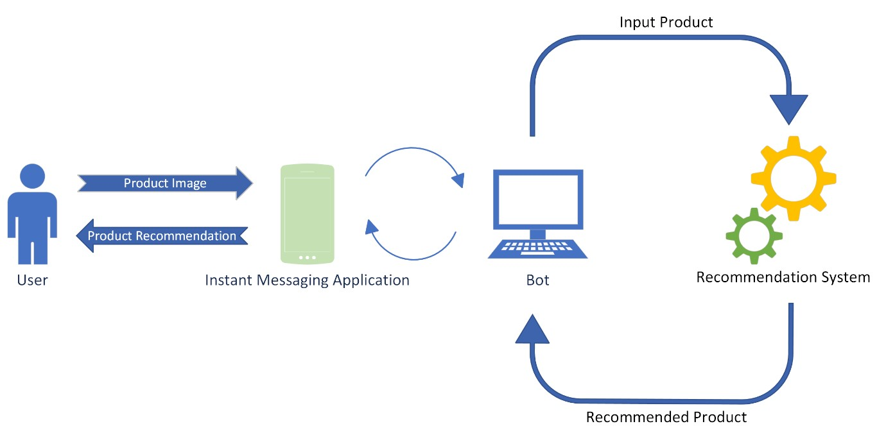
Methodology
This research involved end to end implementation in three phases :
1. Develop bot for end user where user can upload image of the product which will connect to recommendation system.
2. Identify the best model with high accuracy and low loss which can be used to build recommendation system
3. Build recommendation system using identified model which takes input from the user and recommend N products to the user.

Slide 8

Methodology | Bot
In this research we have consider telegram bot for development.
Search for “BotFather” and create new bot by “/newbot” command in telegram from “BotFather” chat.
“BotFather” will return token on successful creation of bot, use this token to communicate with the bot.
Remove the background of image uploaded by user using the telegram bot.
Extract the features from the image and compare with the feature extracted from images present in dataset and recommend N product with the closest feature to the user

Slide 9
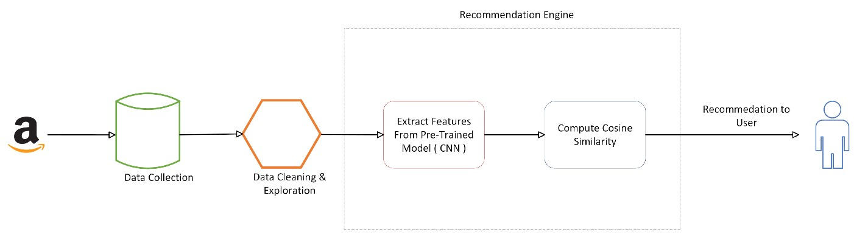
Methodology | Approach
Collected the Amazon product data across different category and store it in CSV file. The data extracted is can be found in: Amazon Dataset.
Load the data in categories and perform data cleaning where by remove duplicates, fill empty cell and preform feature selection and data transformation.
Perform exploratory analysis to explore the trend in the data.
Create image classification model with aim to categories the random image using CNN model.
Compare different model for accuracy and loss
On best model extract feature and compute cosine similarity or nearest neighbour distance of the product and give recommendation.

Slide 10
Methodology | Experiments on Models
After creating data set and downloading all the image. We will first split the data in train and test.
Load below module to train on train dataset.
CNN –SVM
ResNet50
GoogLeNet
VGG16
Xception
Evaluate the model on train, validation and test data to find the accuracy, loss of the models.

Slide 11
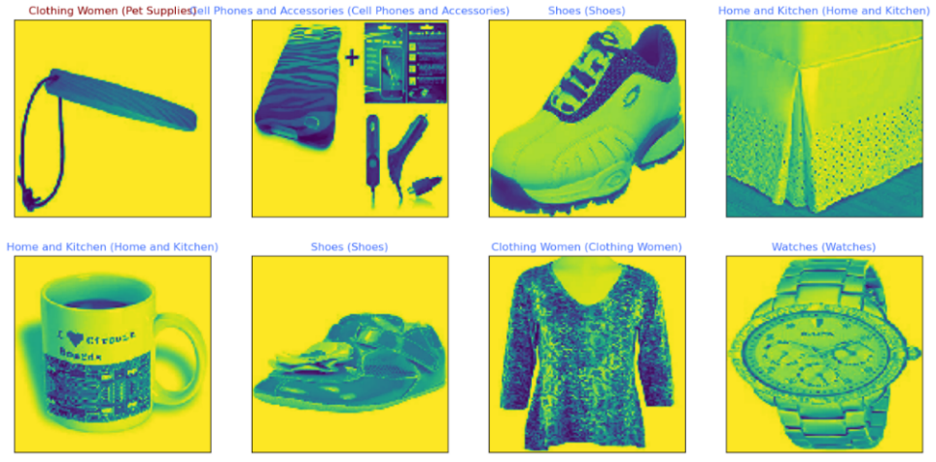
Results & Discussion | CNN Model
As a part of implementation, first we build image classification model with aim to categories the random image using CNN model.
But we saw the result was not accurate.
Mainly because of low accuracy and high loss.
Conclusion – CNN model developed is not accurate and we need to look for model with high accuracy and low loss.

Slide 12
Results & Discussion | Experiments on Models
After evaluating models like CNN, ResNet-50, GoogLeNet, VGG16 and Xception on training and test data, we found that VGG16 model with high accuracy and low loss across train, validation and test data.

Slide 13

Results & Discussion | Image Recommendation Model
Extract image features of data set using VGG16 (pre-trained model)
Extract image features of data provided by user using VGG16 model
Compute nearest neighbours distance of any image features
Recommend N product based on high score / distance

Slide 14
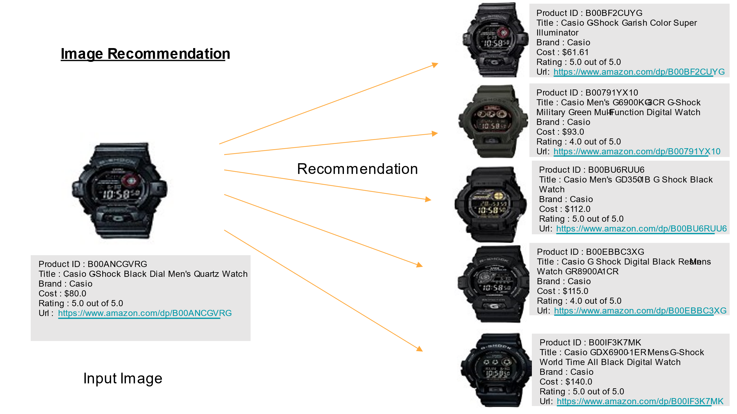
Conclusion
In this research we have build recommendation system which recommend product based on visual/ features and similarity and integrated it with telegram bot.
The research found the VGG16 as best mode on given dataset with accuracy of 85.41% and loss of 0.48.
The research demonstrated the potential of image-based recommendation systems to enhance the user experience and engagement on online platforms, and to support businesses and organizations in their marketing and sales efforts

Slide 15
Future works
Incorporate user feedback: Another way to improve image-based recommendation systems is to incorporate user feedback into the recommendation process and use this feedback to improve the accuracy of the system over time.
Increase scalability: As the dataset increases, increasing the scalability of system using distributed computing techniques, such as parallel processing, to enable the systems to handle larger datasets and serve more users.
Multi-model implementation: Combine image classification model, title and brand recommendation model and image recommendation model to recommend product.
Explore GoogLeNet model by training the dataset on more epochs.

Slide 16
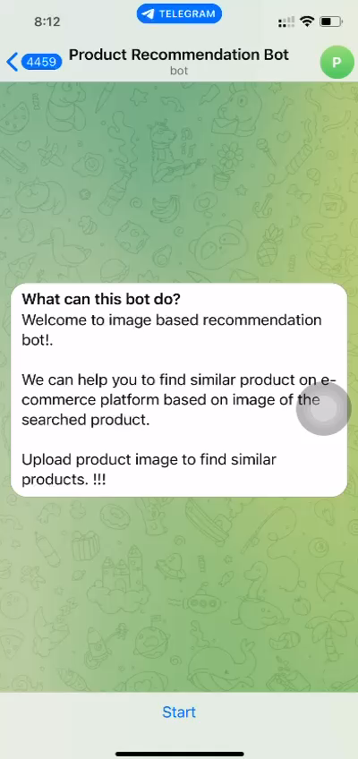
Demo
1. To access image based recommendation bot open telegram and search for @ml_product_recommendation_bot or click on below link.
Link - http://t.me/ml_product_recommendation_bot
2. Click on Start or type /start to start the application.
3. Upload or click product image to find the similar product.

Slide 17
THANK YOU !

